Slide 1




СТРОКИ

Slide 2


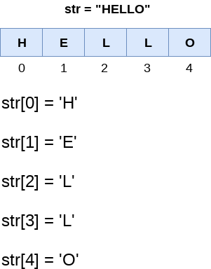
СТРОКИ

Slide 3

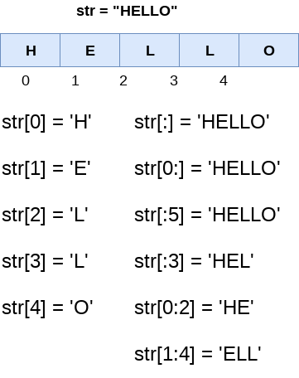
СТРОКИ

Slide 4


СПИСКИ

Slide 5




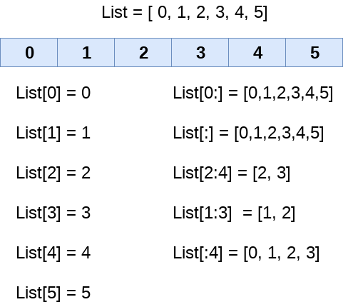
СПИСКИ

Slide 6


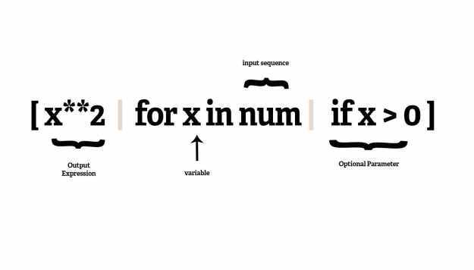
СПИСКИ

Slide 7

КОРТЕЖИ

Slide 8
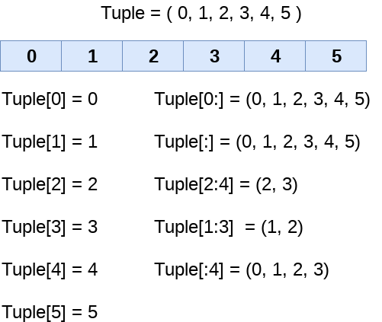
КОРТЕЖИ

Slide 9
Кортежи vs Списки
Tuple | List
A tuple consists of immutable objects. (Objects which cannot change after creation) | A list consists of mutable objects. (Objects which can be changed after creation)
Tuple has a small memory. | List has a large memory.
Tuple is stored in a single block of memory. | List is stored in two blocks of memory (One is fixed sized and the other is variable sized for storing data)
Creating a tuple is faster than creating a list. | Creating a list is slower because two memory blocks need to be accessed.
An element in a tuple cannot be removed or replaced. | An element in a list can be removed or replaced.
A tuple has data stored in () brackets. For example, (1,2,3) | A list has data stored in [] brackets. For example, [1,2,3]

Slide 10

СЛОВАРИ

Slide 11
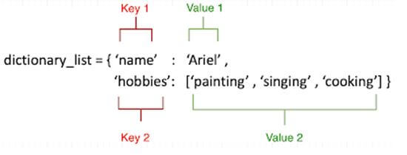
СЛОВАРИ

Slide 12
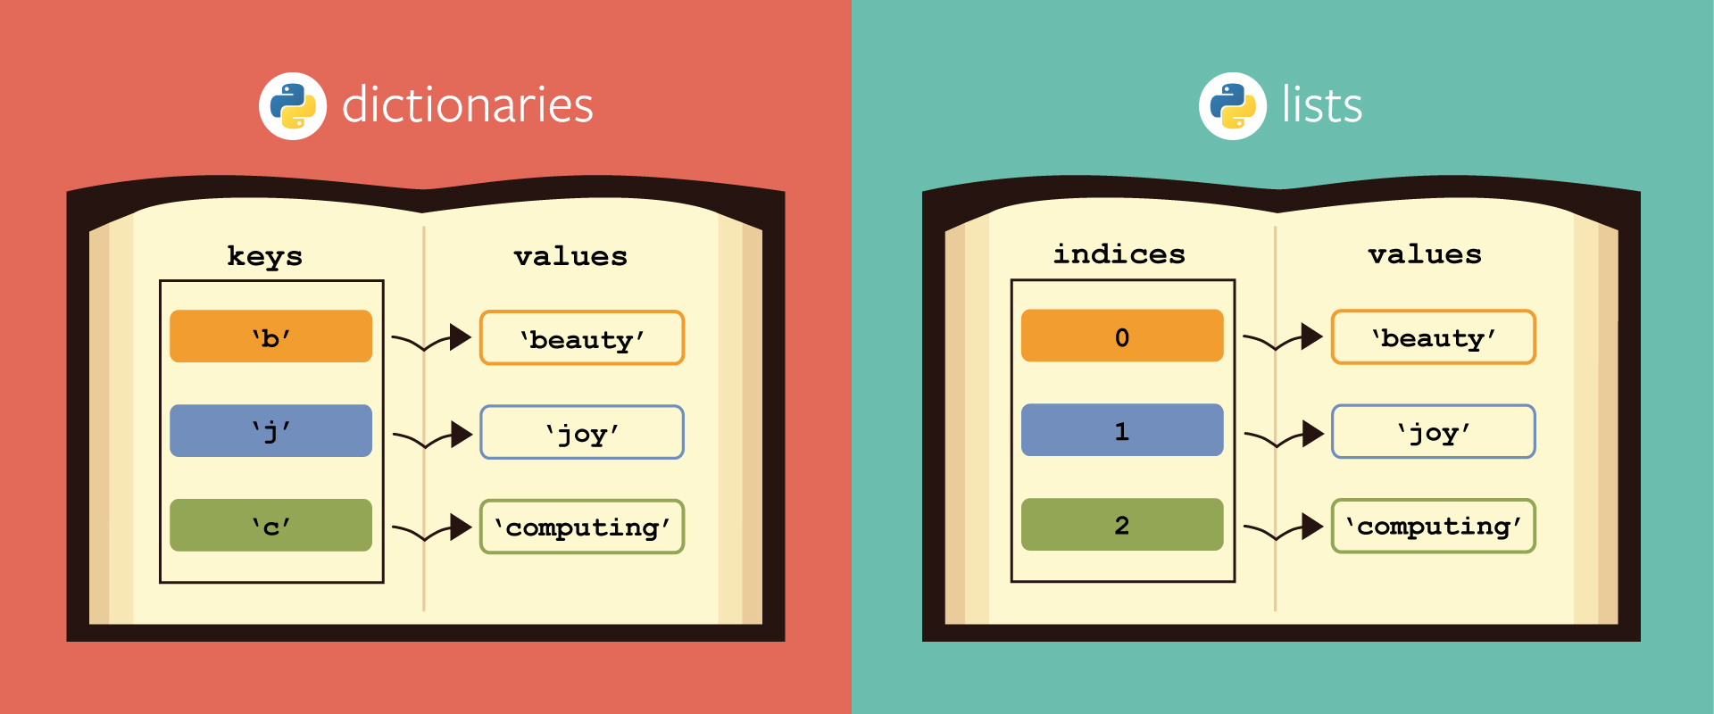
СЛОВАРИ

Slide 13

МНОЖЕСТВО

Slide 14
Множество
Множество в python - "контейнер", содержащий не повторяющиеся элементы в случайном порядке.
Code
arr = [1, 2, 3, 1, 2, 3, 4]
print(set(arr))
Output:
{1, 2, 3, 4}
Отличие set от frozenset заключается в том, что set - изменяемый тип данных, а frozenset - нет.

Slide 15
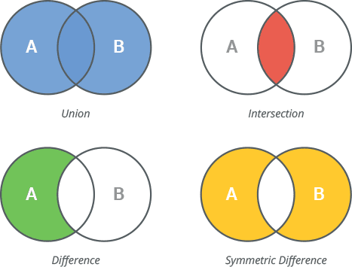
Множество

